Slide 1
Data Structures and Algorithms

Slide 2
Outline
2.2
This topic will describe:
The concrete data structures that can be used to store information
The basic forms of memory allocation
Contiguous
Linked
Indexed
The prototypical examples of these: arrays and linked lists
Other data structures:
Trees
Hybrids
Higher-dimensional arrays
Finally, we will discuss the run-time of queries and operations on arrays and linked lists

Slide 3
Memory Allocation
2.2.1
Memory allocation can be classified as either
Contiguous
Linked
Indexed
Prototypical examples:
Contiguous allocation: arrays
Linked allocation: linked lists

Slide 4
Memory Allocation
2.2.1.1
Contiguous, adj.
Touching or connected throughout in an unbroken sequence.
Meriam Webster
Touching, in actual contact, next in space; meeting at a common boundary, bordering, adjoining.
www.oed.com

Slide 5
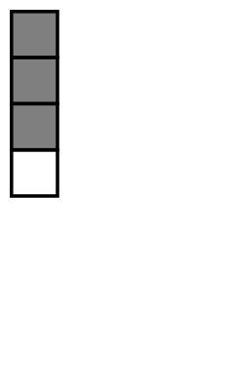
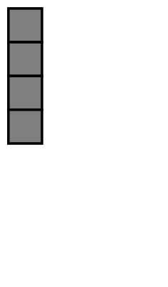
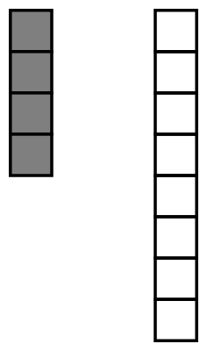
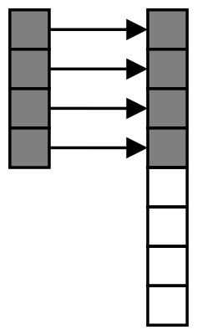
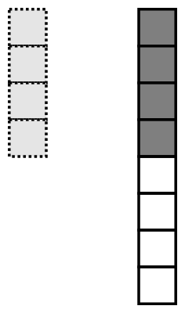
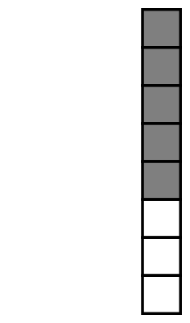

Contiguous Allocation
2.2.1
2.2.1.1
An array stores n objects in a single contiguous space of memory
Unfortunately, if more memory is required, a request for new memory usually requires copying all information into the new memory
In general, you cannot request for the operating system to allocate to you the next n memory locations

Slide 6

Linked Allocation
2.2.1.2
Linked storage such as a linked list associates two pieces of data with each item being stored:
The object itself, and
A reference to the next item
In C++ that reference is the address of the next node

Slide 7
Linked Allocation
2.2.1.2
This is a class describing such a node
template <typename Type>
class Node {
private:
Type element;
Node *next_node;
public:
// ...
};

Slide 8
Linked Allocation
2.2.1.2
The operations on this node must include:
Constructing a new node
Accessing (retrieving) the value
Accessing the next pointer
Node( const Type& = Type(), Node* = nullptr );
Type retrieve() const;
Node *next() const;
Pointing to nothing has been represented as:
C NULL
Java/C# null
C++ (old) 0
C++ (new) nullptr
Symbolically Ø

Slide 9
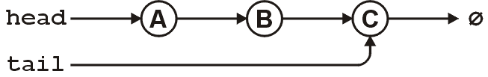
Linked Allocation
2.2.1.2
For a linked list, however, we also require an object which links to the first object
The actual linked list class must store two pointers
A head and tail:
Node *head;
Node *tail;
Optionally, we can also keep a count
int count;
The next_node of the last node is assigned nullptr

Slide 10
Linked Allocation
2.2.1.2
The class structure would be:
template <typename Type>
class List {
private:
Node<Type> *head;
Node<Type> *tail;
int count;
public:
// constructor(s)...
// accessor(s)...
// mutator(s)...
};

Slide 11
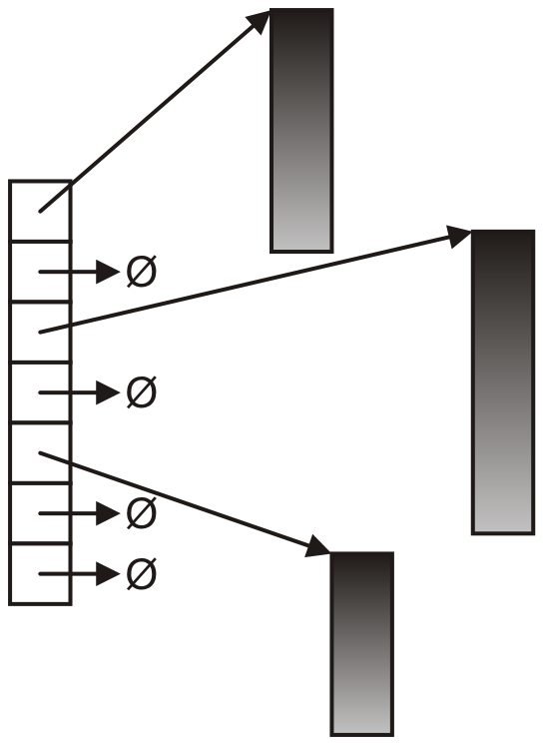
Indexed Allocation
2.2.1.3
With indexed allocation, an array of pointers (possibly NULL) link to a sequence of allocated memory locations
Used in the C++ standard template library
Computer engineering students will see indexed allocation in their operating systems course

Slide 12
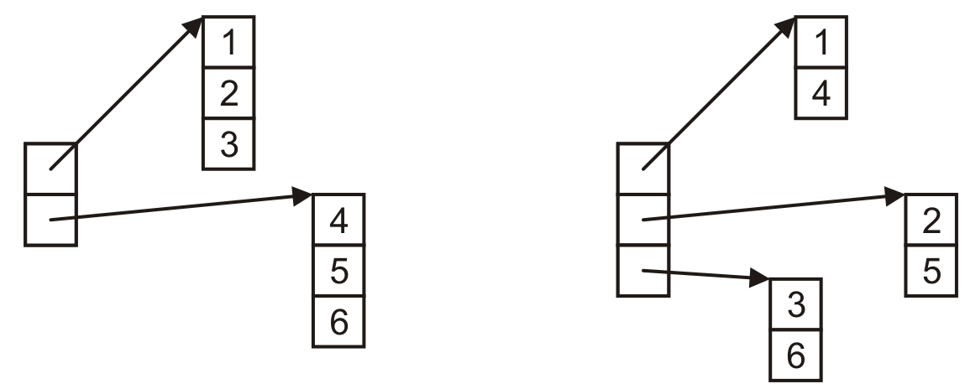
Indexed Allocation
2.2.1.3
Matrices can be implemented using indexed allocation:

Slide 13
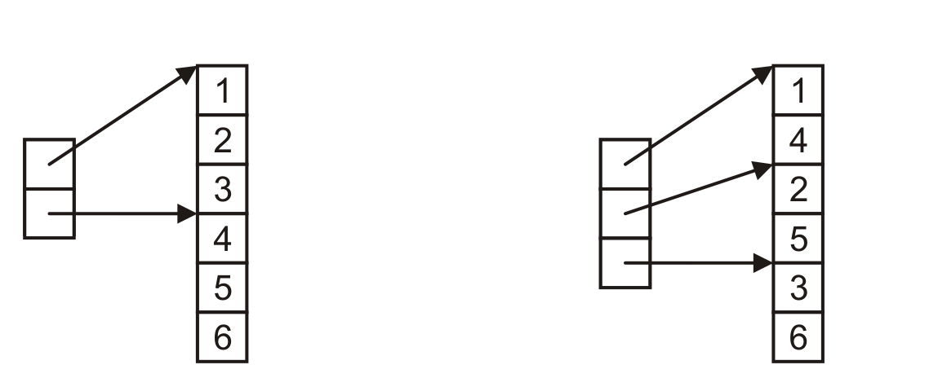
Indexed Allocation
2.2.1.3
Matrices can be implemented using indexed allocation
Most implementations of matrices (or higher-dimensional arrays) use indices pointing into a single contiguous block of memory
Row-major order
Column-major order
C, Python
Matlab, Fortran

Slide 14
Other Allocation Formats
2.2.2
We will look at some variations or hybrids of these memory allocations including:
Trees
Graphs
Deques (linked arrays)
inodes

Slide 15
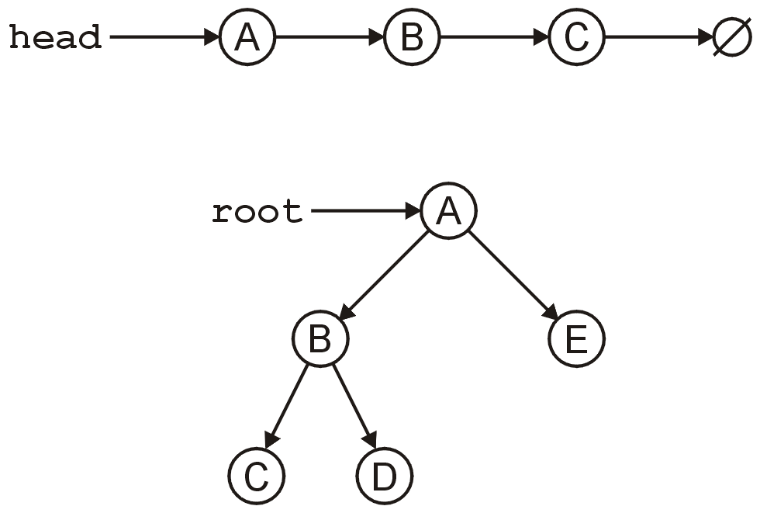
Trees
2.2.2.2
The linked list can be used to store linearly ordered data
What if we have multiple next pointers?
A rooted tree (weeks 4-6) is similar to a linked list but with multiple next pointers

Slide 16
Trees
2.2.2.2
A tree is a variation on a linked list:
Each node points to an arbitrary number of subsequent nodes
Useful for storing hierarchical data
We will see that it is also useful for storing sorted data
Usually we will restrict ourselves to trees where each node points to at most two other nodes

Slide 17
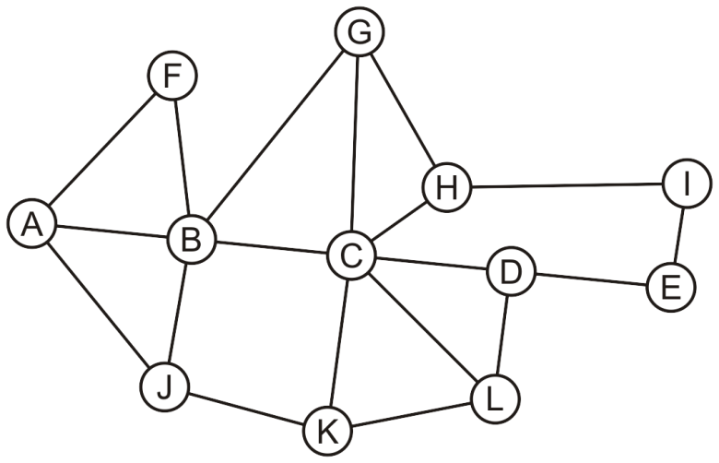
Graphs
2.2.2.2
Suppose we allow arbitrary relations between any two objects in a container
Given n objects, there are n² – n possible relations
If we allow symmetry, this reduces to
For example, consider the network

Slide 18
Arrays
2.2.2.2
Suppose we allow arbitrary relations between any two objects in a container
We could represent this using a two-dimensional array
In this case, the matrix is symmetric
 | A | B | C | D | E | F | G | H | I | J | K | L
A |  | × |  |  |  | × |  |  |  | ×
B | × |  | × |  |  | × | × |  |  | ×
C |  | × |  | × |  |  | × | × |  |  | × | ×
D |  |  | × |  | × |  |  |  |  |  |  | ×
E |  |  |  | × |  |  |  |  | ×
F | × | ×
G |  | × | × |  |  |  |  | ×
H |  |  | × |  |  |  | × |  | ×
I |  |  |  |  | × |  |  | ×
J | × | × |  |  |  |  |  |  |  |  | ×
K |  |  | × |  |  |  |  |  |  | × |  | ×
L |  |  | × | × |  |  |  |  |  |  | ×

Slide 19
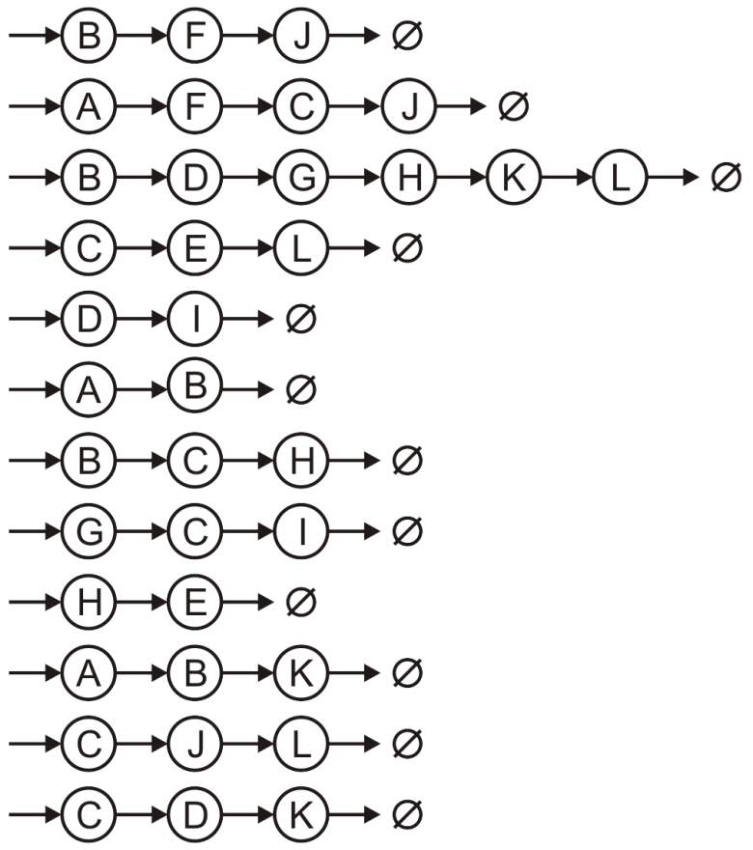
Array of Linked Lists
2.2.2.2
Suppose we allow arbitrary relations between any two objects in a container
Alternatively, we could use a hybrid: an array of linked lists
A
B
C
D
E
F
G
H
I
J
K
L

Slide 20
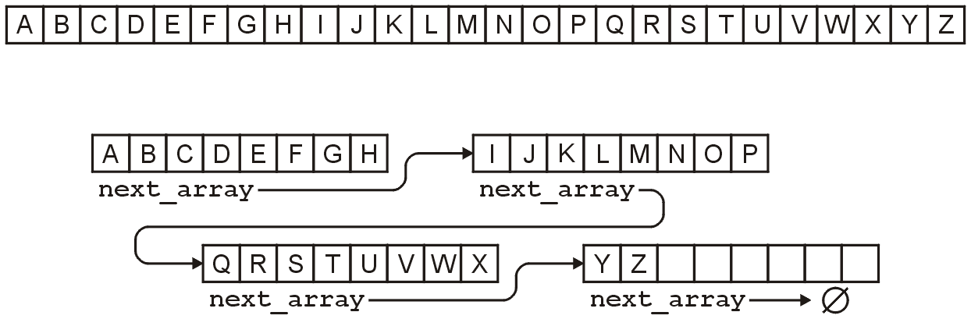
Linked Arrays
2.2.2.3
Other hybrids are linked lists of arrays
Something like this is used for the C++ STL deque container
For example, the alphabet could be stored either as:
An array of 26 entries, or
A linked list of arrays of 8 entries

Slide 21
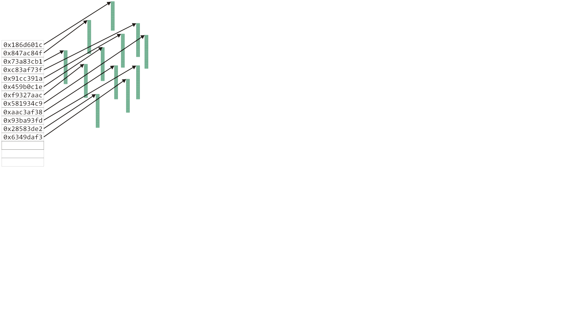
Hybrid data structures
2.2.2.4
The Unix inode was used to store information about large files
The first twelve entries can reference the first twelve blocks (48 KiB)

Slide 22
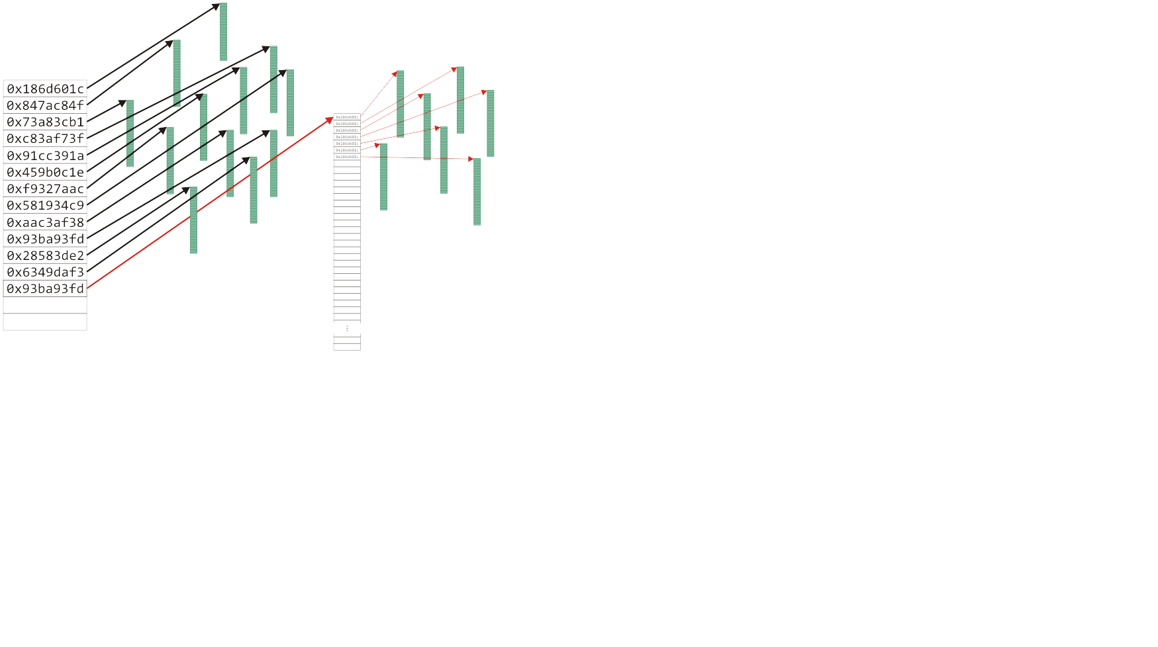
Hybrid data structures
2.2.2.4
The Unix inode was used to store information about large files
The next entry is a pointer to an array that stores the next 1024 blocks
This stores files up to 4 MiB on a 32-bit computer

Slide 23
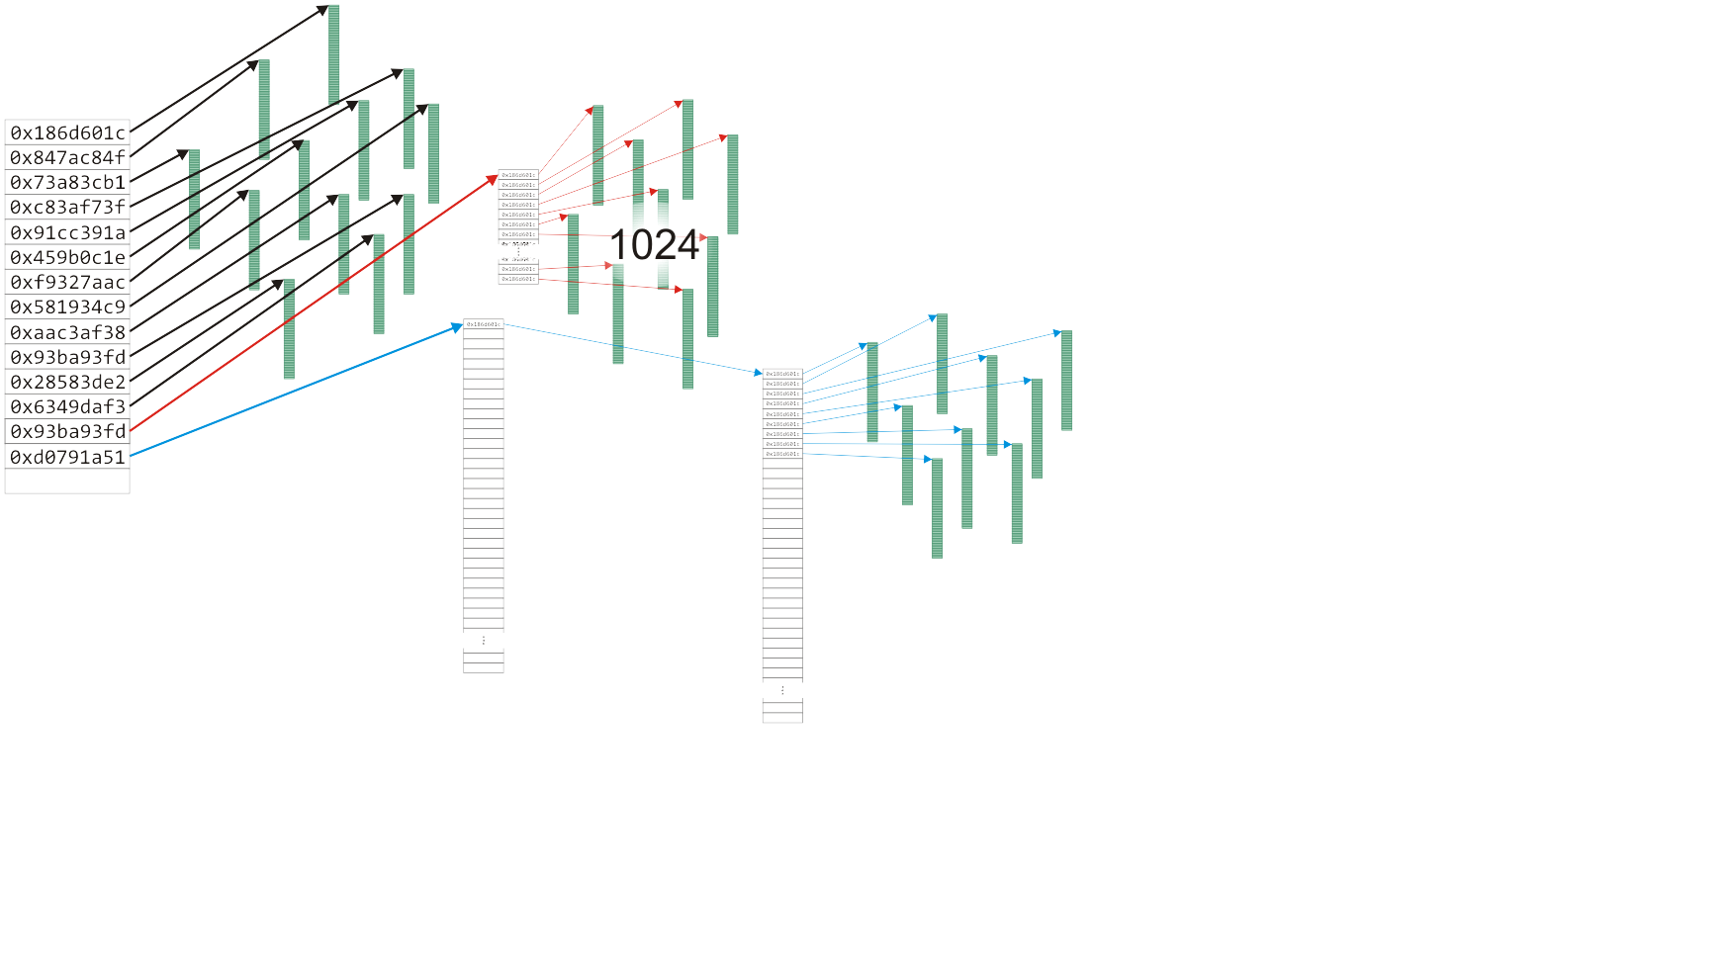
Hybrid data structures
2.2.2.4
The Unix inode was used to store information about large files
The next entry has two levels of indirection for files up to 4 GiB
Notes:
23

Slide 24
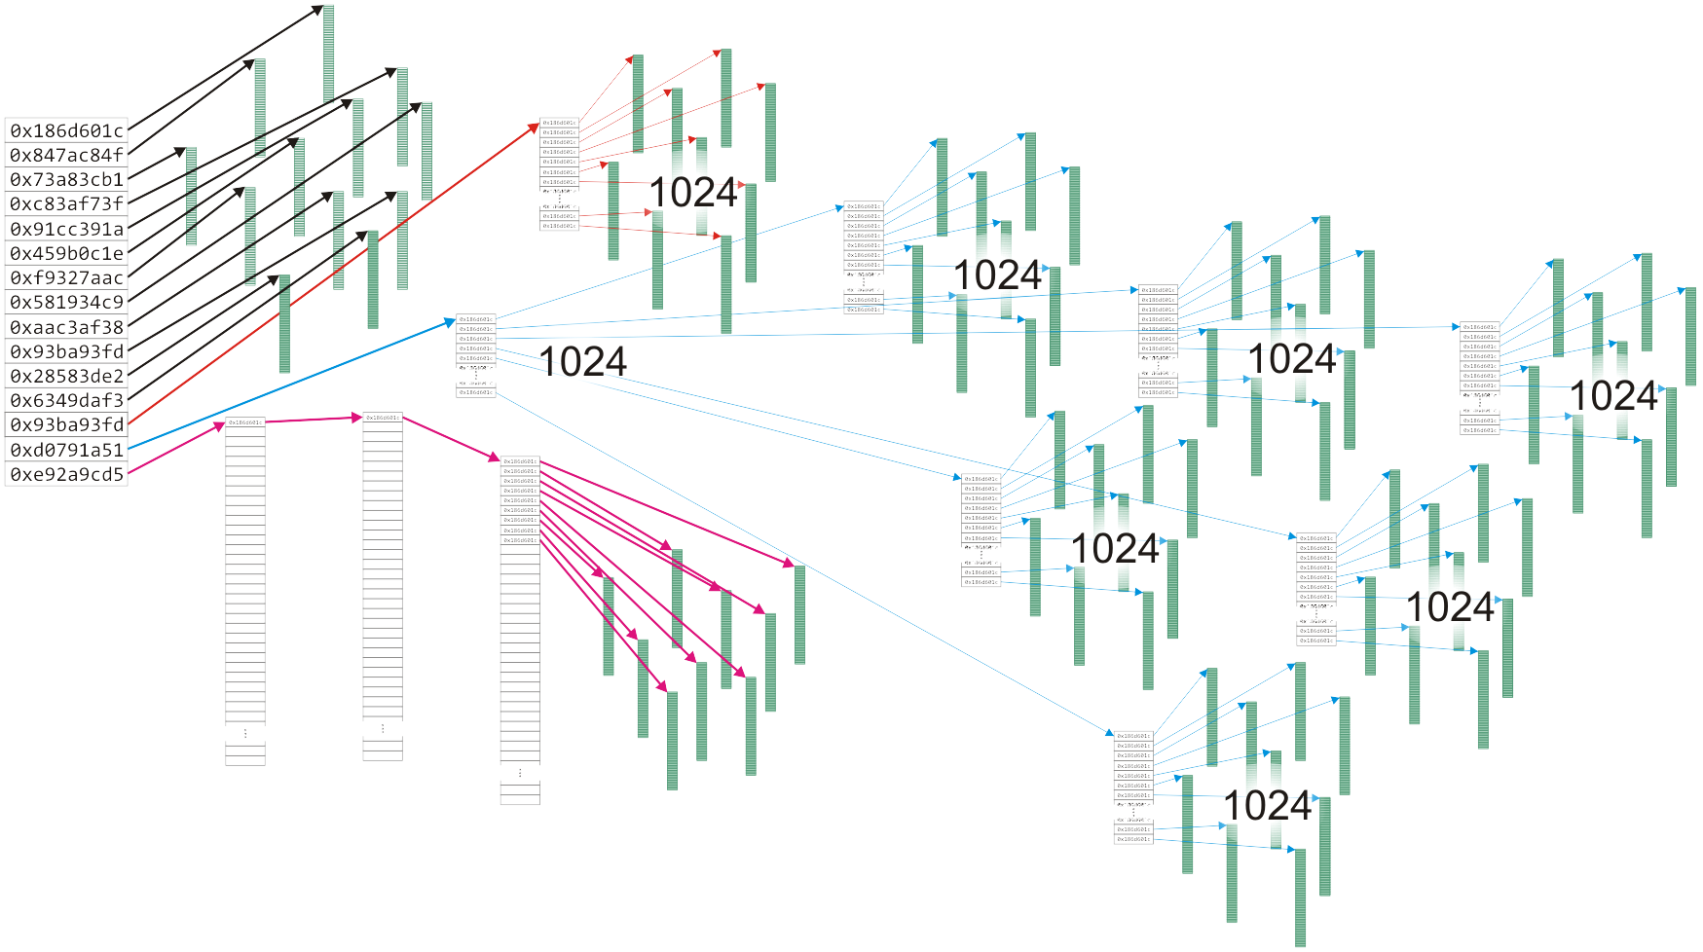
Hybrid data structures
2.2.2.4
The Unix inode was used to store information about large files
The last entry has three levels of indirection for files up to 4 TiB
Notes:
24

Slide 25
Algorithm run times
2.2.3
Once we have chosen a data structure to store both the objects and the relationships, we must implement the queries or operations as algorithms
The Abstract Data Type will be implemented as a class
The data structure will be defined by the member variables
The member functions will implement the algorithms
The question is, how do we determine the efficiency of the algorithms?

Slide 26
Operations
2.2.3
We will us the following matrix to describe operations at the locations within the structure
 | Front/1st | Arbitrary Location | Back/n^{th}
Find | ? | ? | ?
Insert | ? | ? | ?
Erase | ? | ? | ?

Slide 27
Operations on Sorted Lists
2.2.3.1
Given an sorted array, we have the following run times:
 | Front/1st | Arbitrary Location | Back/n^{th}
Find | Good | Okay | Good
Insert | Bad | Bad | Good* | Bad
Erase | Bad | Bad | Good
* only if the array is not full

Slide 28
Operations on Lists
2.2.3.2
 | Front/1st | Arbitrary Location | Back/n^{th}
Find | Good | Bad | Good
Insert | Bad | Bad | Good* | Bad
Erase | Bad | Bad | Good
* only if the array is not full
If the array is not sorted, only one operations changes:
Notes:
28

Slide 29
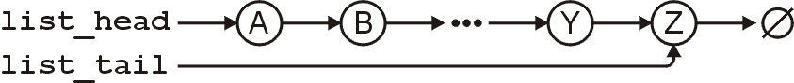
Operations on Lists
2.2.3.3
However, for a singly linked list where we a head and tail pointer, we have:
 | Front/1st | Arbitrary Location | Back/n^{th}
Find | Good | Bad | Good
Insert | Good | Bad | Good
Erase | Good | Bad | Bad

Slide 30
Operations on Lists
2.2.3.3
If we have a pointer to the k^{th} entry, we can insert or erase at that location quite easily
Note, this requires a little bit of trickery: we must modify the value stored in the k^{th} node
This is a common co-op interview question!
 | Front/1st | Arbitrary Location | Back/n^{th}
Find | Good | Bad | Good
Insert | Good | Good | Good
Erase | Good | Good | Bad

Slide 31
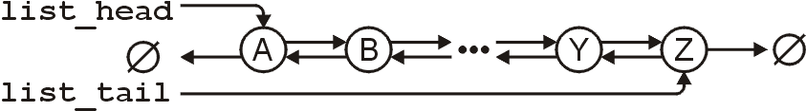
Operations on Lists
2.2.3.4
For a doubly linked list, one operation becomes more efficient:
 | Front/1st | Arbitrary Location | Back/n^{th}
Find | Good | Bad | Good
Insert | Good | Good | Good
Erase | Good | Good | Good

Slide 32
Following Classes
The next topic, asymptotic analysis, will provide the mathematics that will allow us to measure the efficiency of algorithms
It will also allow us the measure the memory requirements of both the data structure and any additional memory required by the algorithms

Slide 33
Following Classes
Following our discussion on asymptotic and algorithm analysis, we will spend
13 lectures looking at data structures for storing linearly ordered data
One week looking at data structures for relation-free data
Four lectures on sorting
One week on partial orderings and adjacency relations, and
Two weeks on algorithm design techniques

Slide 34
Summary
In this topic, we have introduced the concept of data structures
We discussed contiguous, linked, and indexed allocation
We looked at arrays and linked lists
We considered
Trees
Two-dimensional arrays
Hybrid data structures
We considered the run time of the algorithms required to perform various queries and operations on specific data structures:
Arrays and linked lists

Slide 35
References
Wikipedia, https://en.wikipedia.org/wiki/Data_structure
These slides are provided for the ECE 250 Algorithms and Data Structures course. The material in it reflects Douglas W. Harder’s best judgment in light of the information available to him at the time of preparation. Any reliance on these course slides by any party for any other purpose are the responsibility of such parties. Douglas W. Harder accepts no responsibility for damages, if any, suffered by any party as a result of decisions made or actions based on these course slides for any other purpose than that for which it was intended.

